Slide 1
Supportlytics
Data-Driven Optimization of IT Support Team Performance Using Advanced Analytics
Milestone 2 (Week 3–4) • Infosys Springboard
Presented By
Uma Parvathi Devi Nakireddy

Slide 2

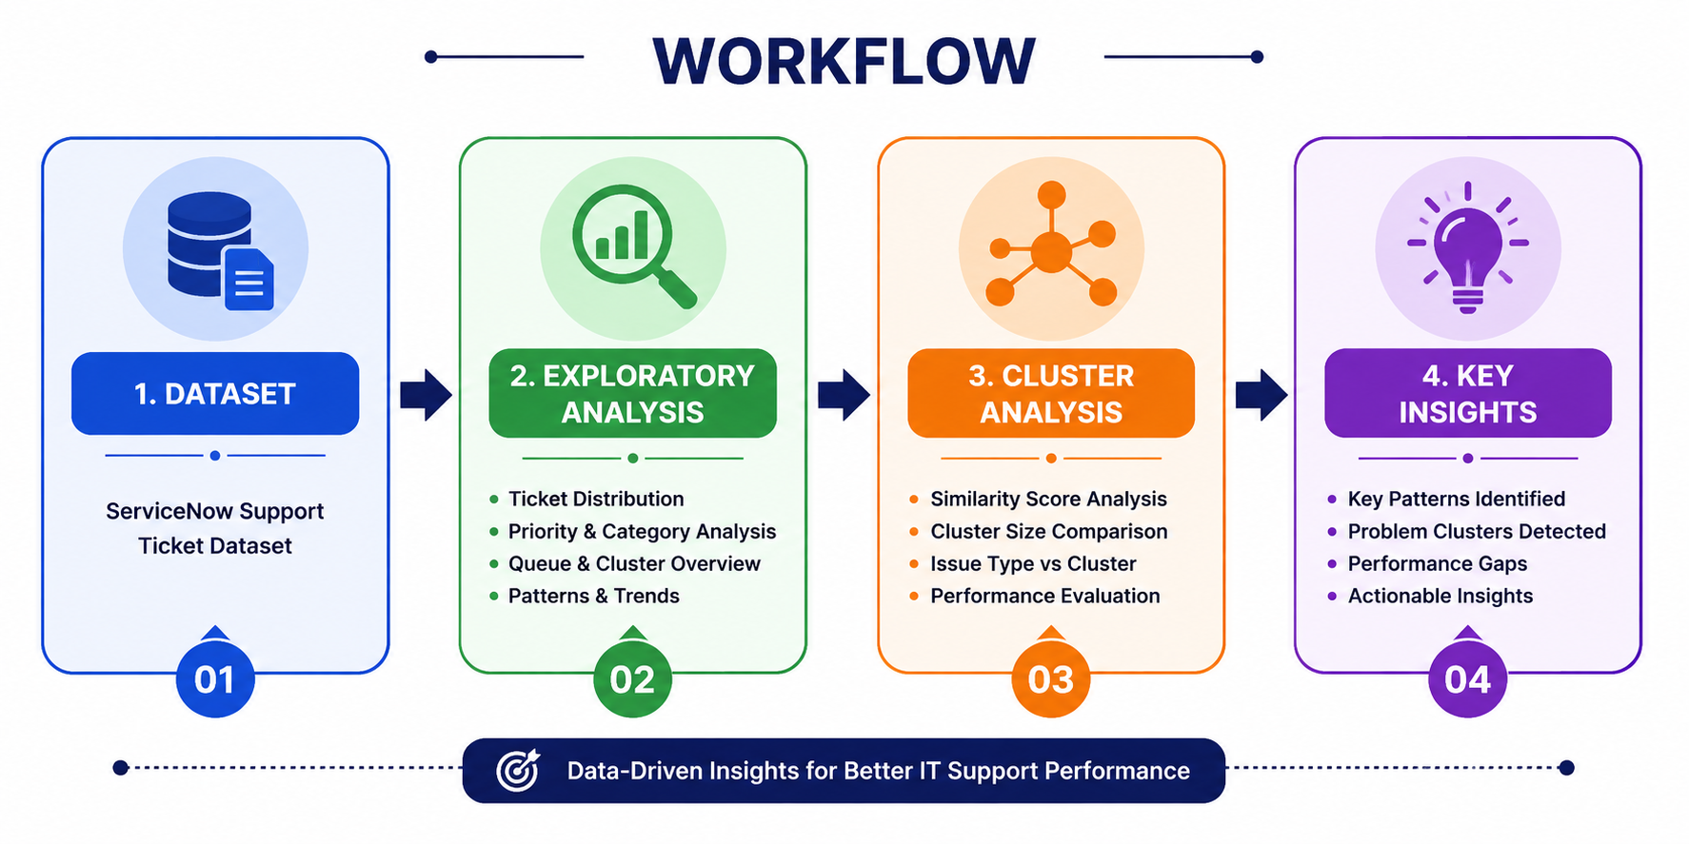
Milestone 2 — Overview
Objective: Complete exploratory visualization and cluster-based similarity analysis to surface actionable support trends and performance gaps.
Modules Covered
Workflow
Module 3 — Exploratory Visualization
Module 4 — Similarity & Cluster Insights
Dataset → Exploratory Analysis → Cluster Analysis → Key Insights

Slide 3
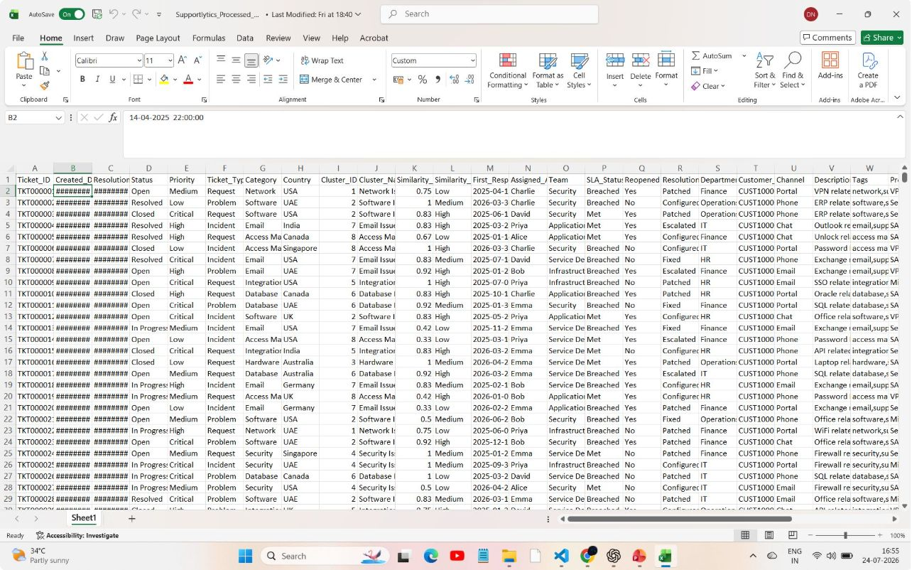
Dataset Overview
Dataset
ServiceNow support ticket dataset capturing incidents, categories, priorities, timestamps, assign groups, and resolution notes.
Key Columns
ticket_id, created_at, resolved_at, priority, category, assignment_group, resolution_code,cluster
Tools
Python • Pandas • Matplotlib (visualization and preprocessing)

Slide 4
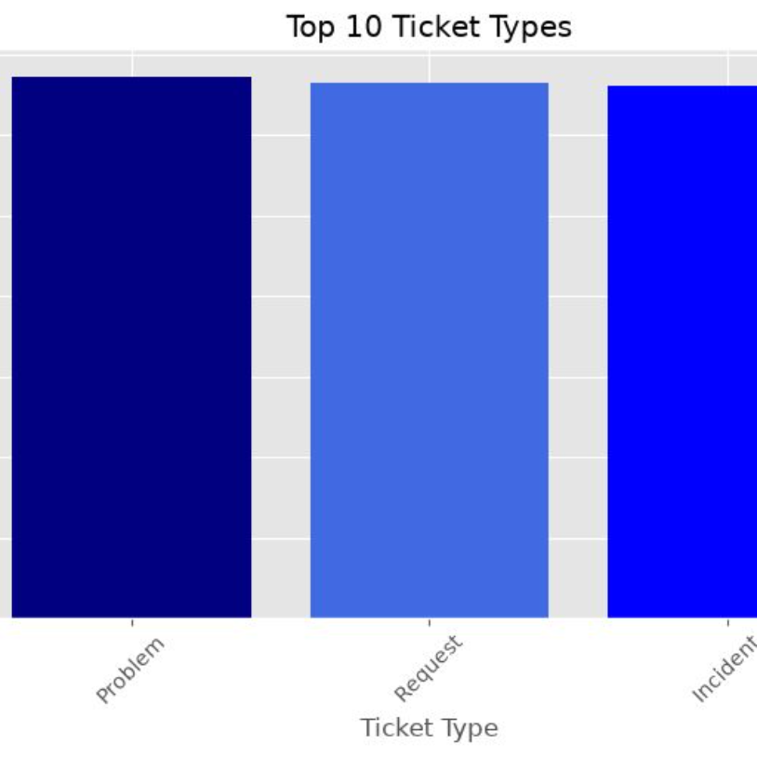
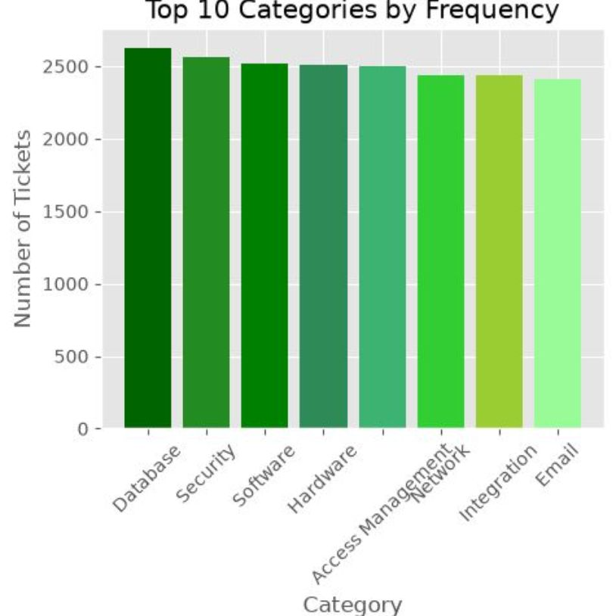
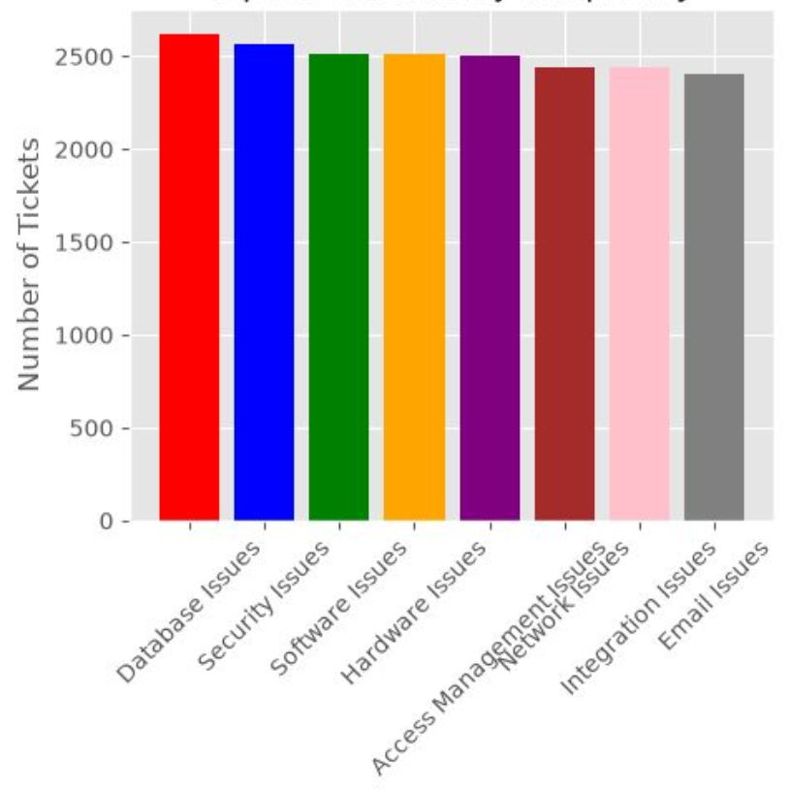
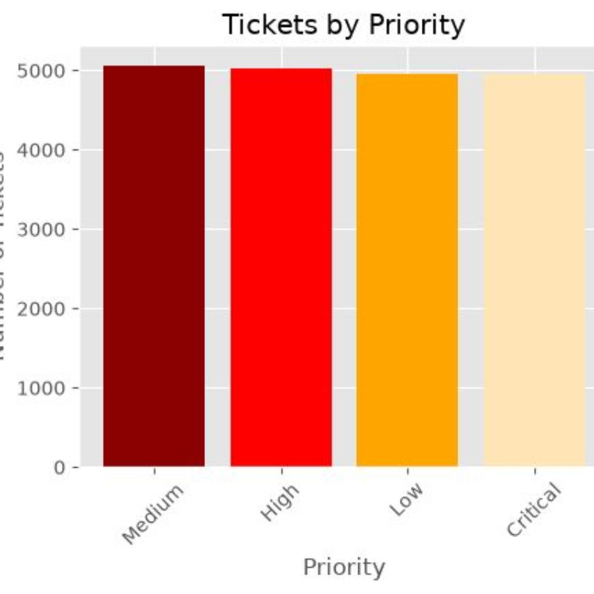
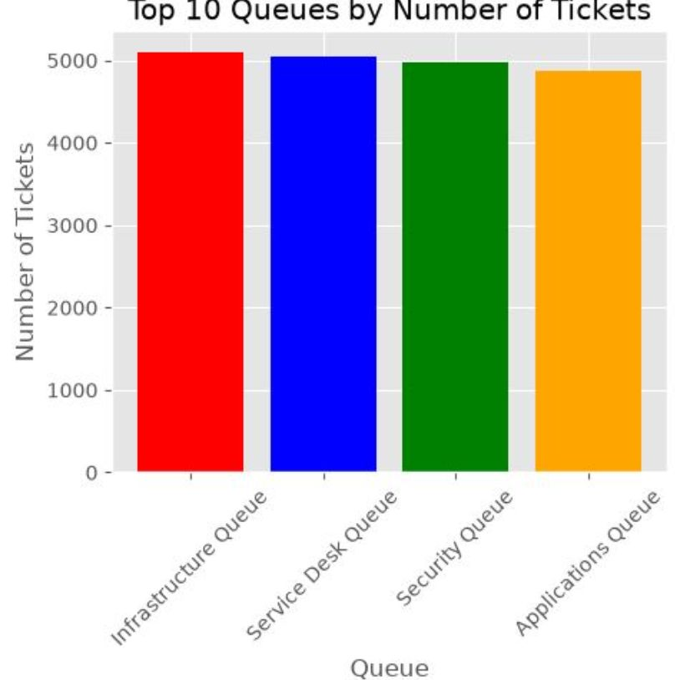
Module 3 — Exploratory Visualizations
Visualization 1
Visualization 2
Visualization 3
Ticket type distribution
Top Categories by Frequency
Top clusters by frequency
Visualization 4
Tickets by Queue
Queue and workload analysis
tickets by Queue
Ticket distribution provides a clear overview of support request patterns.
High-frequency categories represent the most common customer issues.
Cluster analysis identifies recurring issue groups within the dataset.
Priority distribution supports effective ticket prioritization.
Queue analysis illustrates workload allocation across support teams.

Slide 5
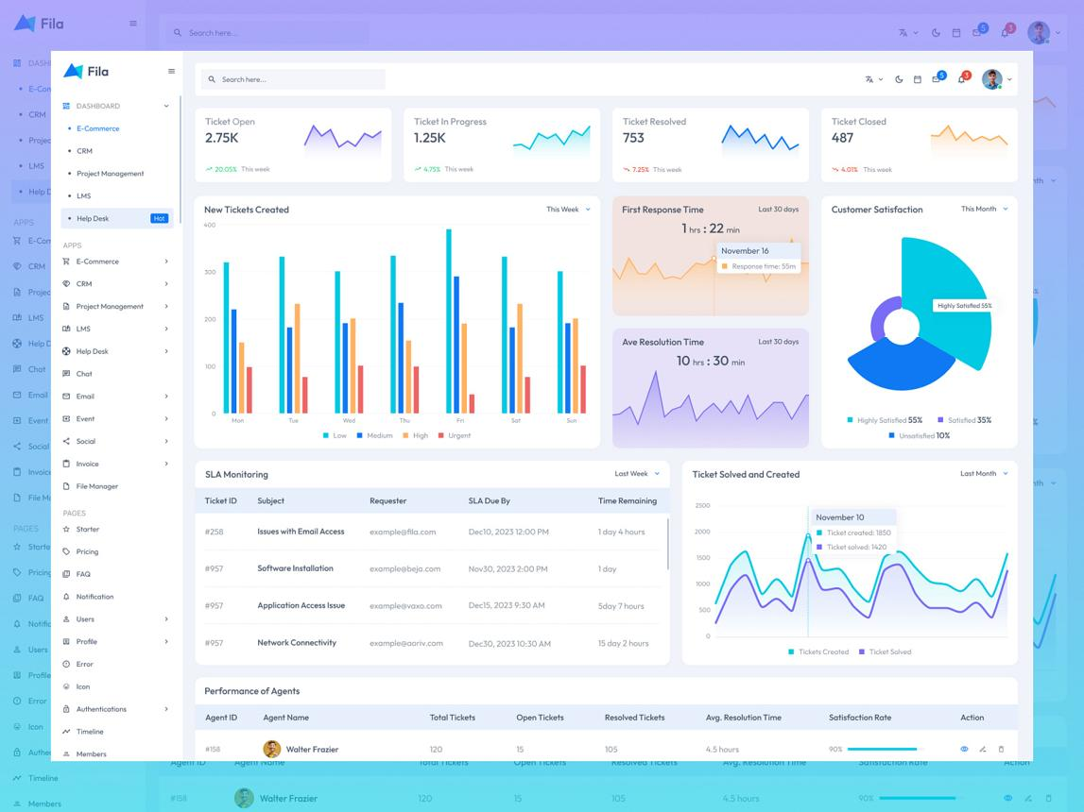
Module 4: Similarity & Cluster Analysis
Created a Cluster column to group similar support tickets.
Calculated the Similarity Score for each ticket using its resolution duration.
Found the average similarity score for each clusters.
Compared different clusters based on their size and issue types.
Analyzed how similarity scores vary across clusters.
Studied the relationship between cluster size and average similarity score.
Identified recurring issue patterns through cluster analysis.terns.

Slide 6
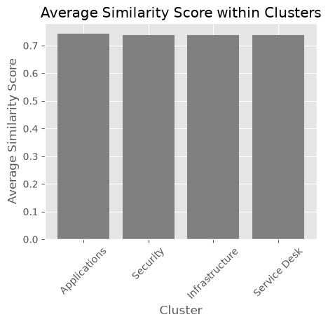

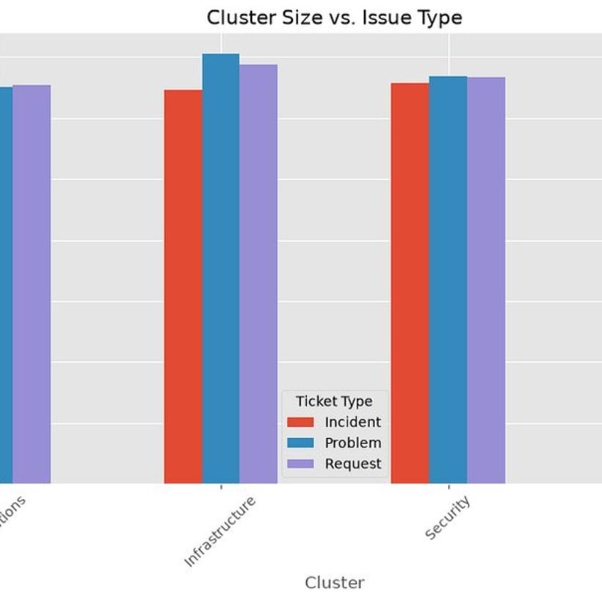
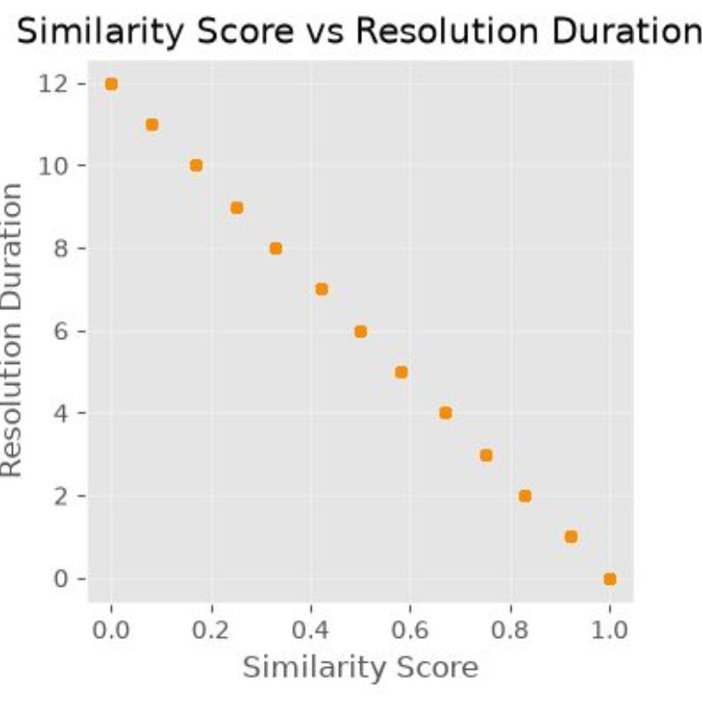
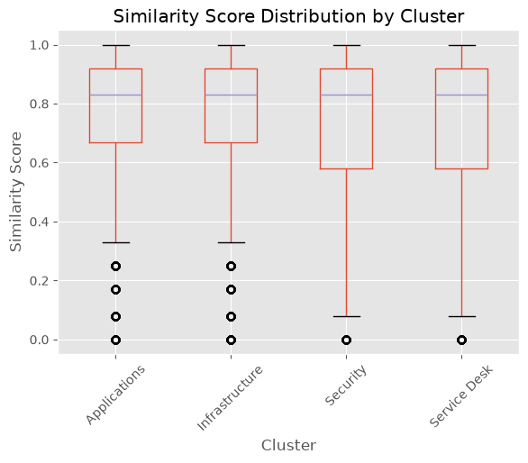
Module 4 — Similarity & Cluster Insights
Four screenshot slots for cluster visualizations: similarity matrix, cluster scatter, centroid profiles, boxplots comparing clusters.
Visualization 1
Visualization 2
Visualization 3
Visualization 4
Average similarity score within clusters
Cluster vs IssueType
Similarity score distribution by Cluster
Similarity score vs Resolution duration
Similarity scores vary across clusters, showing some tight groups and some diffuse clusters.
Larger clusters indicate recurring or high-volume issue families.
Scatter plots reveal relationships and potential mislabeled tickets spanning clusters.
Boxplots highlight performance and resolution-time variation between clusters.

Slide 7
Key Insights
Ticket Patterns
Major Categories
Cluster Behavior
Similarity Trends
Distribution patterns identify top recurring issue types for targeted fixes.
Focused categories account for the bulk of workload — prioritize documentation.
Clusters reveal groups of similar incidents that can be routed or automated.
Similarity scores track evolving issue patterns—use for monitoring drift.
Performance Gaps
Identified clusters with longer resolution times—targets for process improvement.

Slide 8
Challenges & Learning
Challenges
Learning
Choosing visualizations that convey operational meaning to stakeholders.
Interpreting cluster boundaries and handling outliers without overfitting.
Practical EDA techniques to reveal signal in noisy support data.
Effective data visualization best practices with Matplotlib.
Cluster analysis workflows and similarity metrics for ticket grouping.
Improved Python & Pandas skills for production-ready preprocessing.

Slide 9
Similarity & Cluster Analysis Overview
Created clusters to group similar support tickets.
Calculated similarity scores using ticket resolution duration.
Compared the average similarity score of each cluster.
Analyzed cluster size and issue types to identify recurring patterns.
Used data visualizations to understand cluster behavior and support performance

Slide 10

Milestone 2 Summary
In this milestone, I completed Module 3 and Module 4 successfully.
I explored the support ticket data, performed similarity and cluster analysis, and created meaningful visualizations.
Overall, this milestone helped me understand ticket patterns, identify recurring issues, and improve my data analysis skills.

Slide 11
Thank You
I would be happy to answer your questions

